Slide 1
SMART KRISHI
PROJECT ID : 2DS_MP05_2024
MODERN FARMING ANCIENT TOOLS
DOMAIN : AGRICULTURE
SATYAM YADAV
SHIVAM MISHRA
SAURAV CHAUDHARY
SHAN SHARMA
PRESENTED TO : PROJECT CO-ORDINATOR

Slide 2
INDEX
ABSTRACT
  PROBLEM STATEMENT
SOLUTION OVERVIEW
DESIGN
FLOWCHART
CIRCUIT DIAGRAM
SOIL HEALTH MONITORING
CROP PATTERN OPTIMIZATION
AUTOMATED WATER AND FERTILIZER MANAGEMENT
DATA-DRIVEN INSIGHTS FOR DECISION MAKING
USER-FRIENDLY APPLICATION
COMMUNITY ENGAGEMENT AND EDUCATIONAL RESOURCES
FUTURE SCOPE
CONCLUSION
REFERENCES

Slide 3
ABSTRACT
The project focuses on automating irrigation to optimize water usage using an Arduino Uno R3 microcontroller.
Key components include:
Soil moisture sensor: Monitors real-time soil moisture levels.
Temperature and humidity sensor (e.g., DHT11/DHT22): Tracks environmental conditions.
Relay module and water pump: Controls water flow based on sensor data.
Working principle:
The system activates the water pump when soil moisture levels drop below a predefined threshold.
It stops irrigation once optimal moisture levels are restored, conserving water.
Optional enhancements include IoT integration for remote monitoring and control via a mobile app or web interface.

Slide 4
Problem Statement
Indian farmers, who make up about 42% of the workforce, face substantial challenges in optimizing crop yields and managing resources effectively. Despite their vast experience, many lack formal education and a business-oriented mindset, which limits their ability to adopt modern agricultural practices. Over 70% of farmers are smallholders, struggling to earn a decent income. This situation is further aggravated by the absence of real-time data analysis for soil health monitoring and resource management. Tragically, between 2014 and 2020, over 55,000 farmers committed suicide, often due to debt and crop failure, highlighting the urgent need for technology-driven solutions to support these farmers.

Slide 5
Solution Overview
Smart Farming System:
Designed to address challenges faced by Indian farmers.
Enhances productivity and profitability through innovative technology.
Key Features:
Data-Driven Insights:
  Provides actionable recommendations for crop selection and resource allocation.
Automation:
  Automates irrigation and fertilization processes based on real-time data.
Real-Time Monitoring:
  Uses IoT sensors for continuous monitoring of soil health and environmental conditions.
Benefits:
Increases crop yield and quality, reduces costs, and empowers farmers.

Slide 6
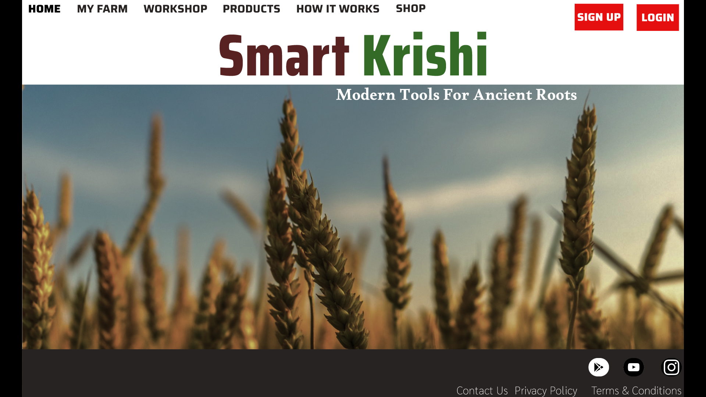

Slide 7
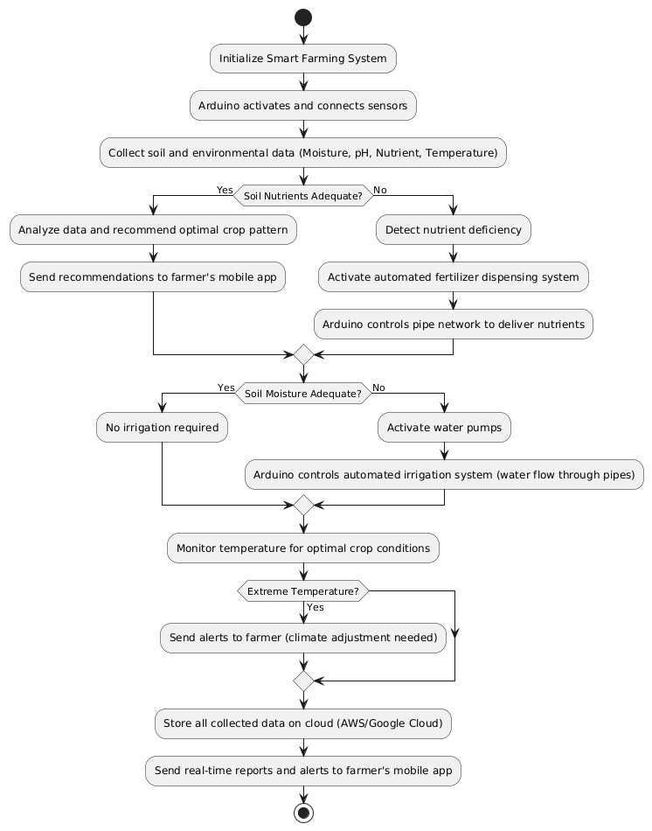
FLOWCHART

Slide 8
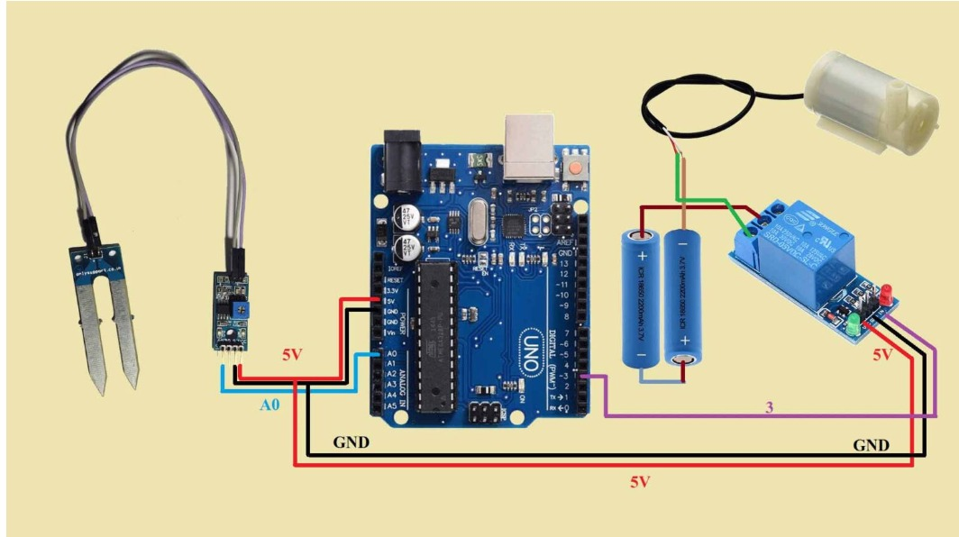

Slide 9
Soil Health Monitoring
Real-Time Data Collection:
  Uses IoT sensors to monitor soil moisture, pH, and nutrient levels continuously.
Soil Health Indicators:
  Assesses soil fertility and identifies nutrient deficiencies for better crop management.
Actionable Insights:
  Provides recommendations for fertilizers and crop selection based on soil conditions.
Early Warning System:
  Alerts farmers to adverse conditions, enabling timely interventions to protect crops.
Long-Term Benefits:
  Promotes sustainable practices, enhances soil quality, and increases productivity and profitability.’

Slide 10
Crop Pattern Optimization
Data Analysis:
Leverages soil data and market trends to recommend optimal crop patterns.
Customized Recommendations:
Suggests crops based on specific soil conditions and regional climate.
Maximized Yield:
Increases productivity by aligning crop choices with soil health.
Resource Efficiency:
Reduces waste by optimizing inputs like water and fertilizers for selected crops.
Higher Income:
Enhances profitability through better crop selection and reduced operational costs.

Slide 11
Automated Water and Fertilizer Management
Automation Technology:
Utilizes sensors and IoT devices to automate irrigation and fertilizer applications.
Real-Time Soil Data:
Adjusts water and fertilizer delivery based on current soil conditions and needs.
Precision Resource Use:
Ensures optimal application rates to match crop requirements, reducing waste.
Cost Efficiency:
Lowers labor costs by minimizing manual intervention and optimizing resource usage.
Environmental Impact:
Reduces runoff and pollution, promoting sustainable farming practices.

Slide 12
Data-Driven Insights for Decision Making
Utilization of Analytics:
Leverages data analysis to generate actionable insights tailored for farmers.
Forecasting Capabilities:
Provides forecasts on market trends, crop performance, and weather conditions.
Informed Decision Making:
Empowers farmers to make better financial choices regarding investments and resource allocation.
Operational Efficiency:
Helps streamline farming operations by identifying best practices and optimizing resource use.
Risk Management:
Equips farmers with information to mitigate risks associated with crop failure and market volatility.

Slide 13
User-Friendly Application
Comprehensive Features:
  Soil Health Data: Real-time insights on soil conditions.
  Crop Recommendations: Tailored suggestions based on soil health and market trends.
  Resource Management: Tools for managing water and fertilizer applications.
User-Centric Design:
Intuitive interface for easy navigation and accessibility.
On-the-Go Access:
Information readily available at farmers' fingertips, enabling quick decisions.
Enhanced Decision-Making:
Empowers farmers to make informed choices, improving productivity and profitability.

Slide 14
Community Engagement and Educational Resources
Knowledge Sharing Platform:
A space for farmers to exchange experiences, tips, and best practices.
Training Modules:
Comprehensive courses on modern agricultural practices and financial literacy.
Resource Accessibility:
Easy access to instructional materials, videos, and guides to enhance farming techniques.
Feedback Loop:
Encourages user input to continuously improve the solution based on farmer needs.
Government Schemes:
Information on available government programs to support farmers’ initiatives.

Slide 15
Future Scope
Complete Package Sales:
Offer a comprehensive smart farming solution that includes hardware, software, and ongoing support.
Subscription Model:
Implement a subscription-based service for continuous access to features, updates, and educational resources.
Continuous Data Tracking:
Regularly collect and analyze user data to enhance AI models and improve recommendations.
Expansion to Diverse Regions:
Adapt and scale the system for various agricultural practices across India and internationally.

Slide 16
Conclusion
Recap: Summarize the key aspects of the Smart Farming Solution, focusing on the integration of real-time data, automation, and education for farmers.
Impact on Farmers:
Boosts Productivity: Ensures efficient use of resources like water and fertilizers, optimizing crop yield.
Increases Income: Recommends profitable crop patterns and reduces input costs.
Improves Well-Being: Eases workload, empowers farmers with knowledge, and fosters a sustainable farming approach.
Call to Action: Highlight the next steps for implementation or adoption of the solution.

Slide 17
REFERENCES
Case Study on Smart Irrigation in India – Published by ICAR (Indian Council of Agricultural Research). (08/09/2024 12:12)
Real-Time Soil Monitoring for Precision Agriculture – Research from the Food and Agriculture Organization (FAO). (18/10/2024 13:12)
Precision Agriculture Technologies and Applications by John V. Stafford. (book)
The Future of Farming: Technology and Innovation by Robert Blair. FAO Website (www.fao.org) for global agricultural data and solutions.
(09/11/2024 13:12)
ICAR Website (www.icar.org.in) for Indian agriculture advancements. (09/12/2024 17:12)

